Slide 1
OOP Practice + Flutter Introduction
Hello Again!!

Slide 2
Outlines
OOP Practice
Flutter introduction
Main()
MaterialApp()
Scaffold()

Slide 3

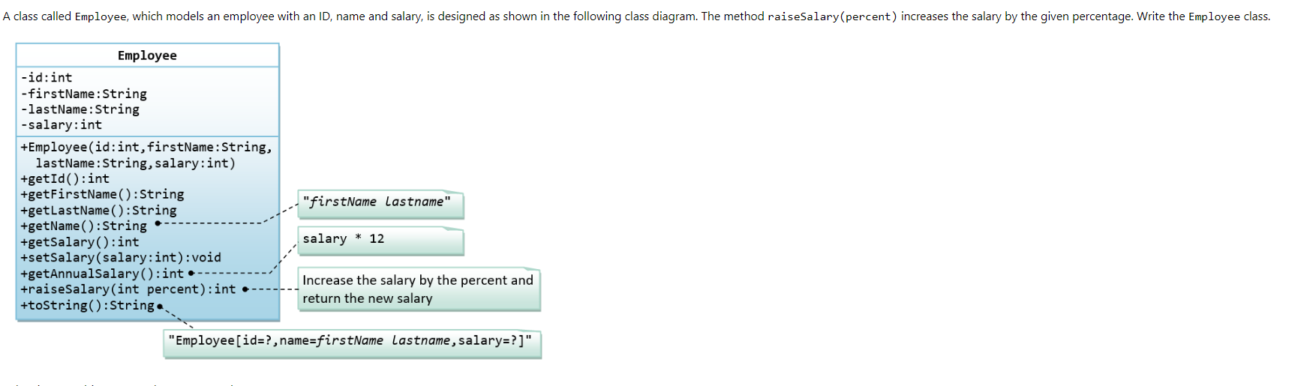
OOP Practice

Slide 4
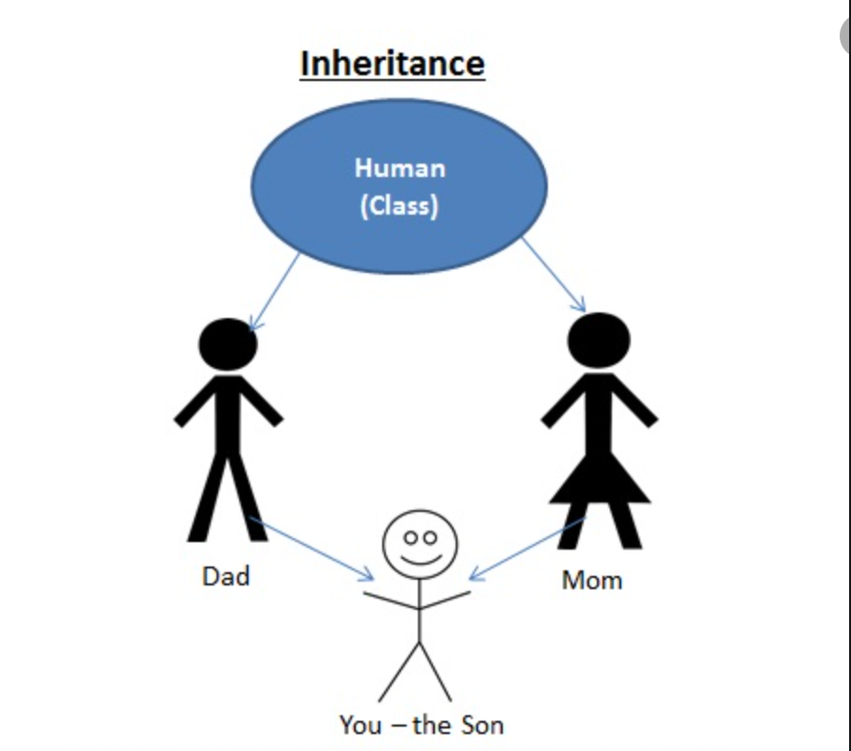
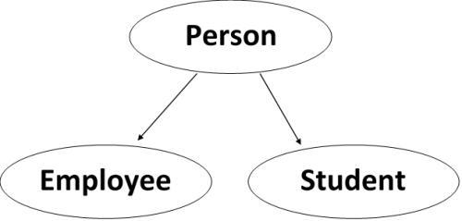
Inheritance
One of the most significant components of Object Oriented Programming is inheritance (OOP). The key to understanding Inheritance is that it provides code re-usability. In place of writing the same code, again and again, we can simply inherit the properties of one class into the other.
Inheritance is a technique of modelling real-world relationships, and OOP is all about real-world objects. Here's an example: a car, a bus, and a bicycle all fall under the umbrella term "vehicle." That is, they have inherited the attributes of the vehicle class, implying that they are all utilised for transportation.
We can represent this relationship in code with the help of inheritance.
An inherited class is called a subclass of its parent class or super class. The term "inheritance" is loosely used for both class-based and prototype-based programming, but in narrow use the term is reserved for class-based programming (one class inherits from another), with the corresponding technique in prototype-based programming being instead called delegation (one object delegates to another).
DRY (Don’t Repeat Yourself)

Slide 5
Let’s Think
Find the inheritance relation between those classes
Vehicle
Car
Truck
BMW
Audi

Slide 6
Solution
Vehicle
Car
Truck
Car
Audi

Slide 7
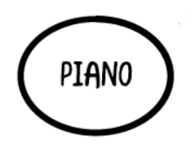





Let’s Think

Slide 8
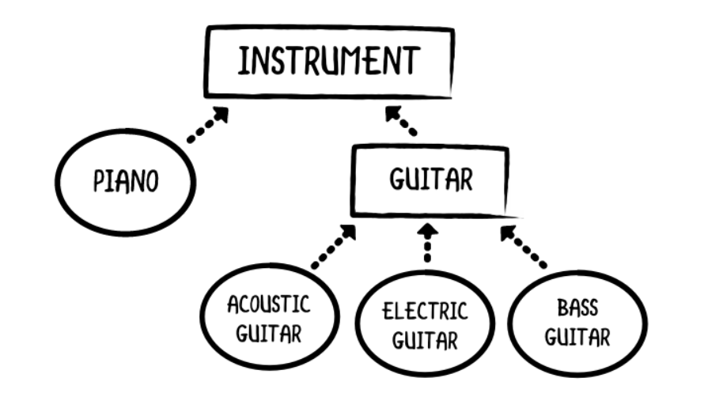
Solution

Slide 9
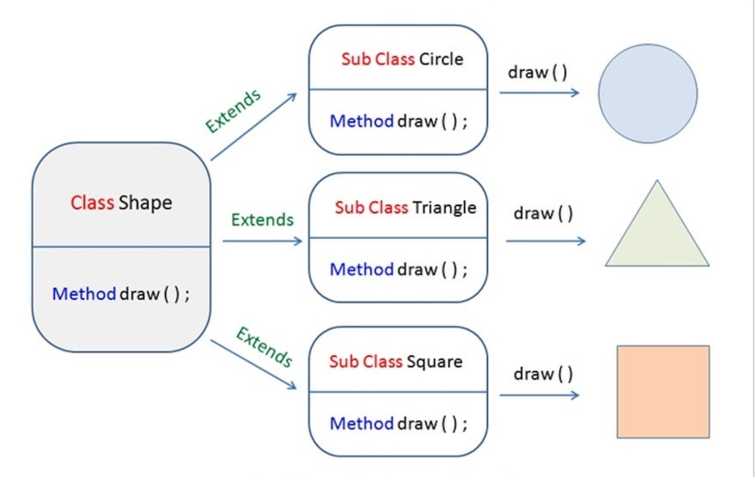
Polymorphism Overriding

Slide 10
Polymorphism Casting

Slide 11
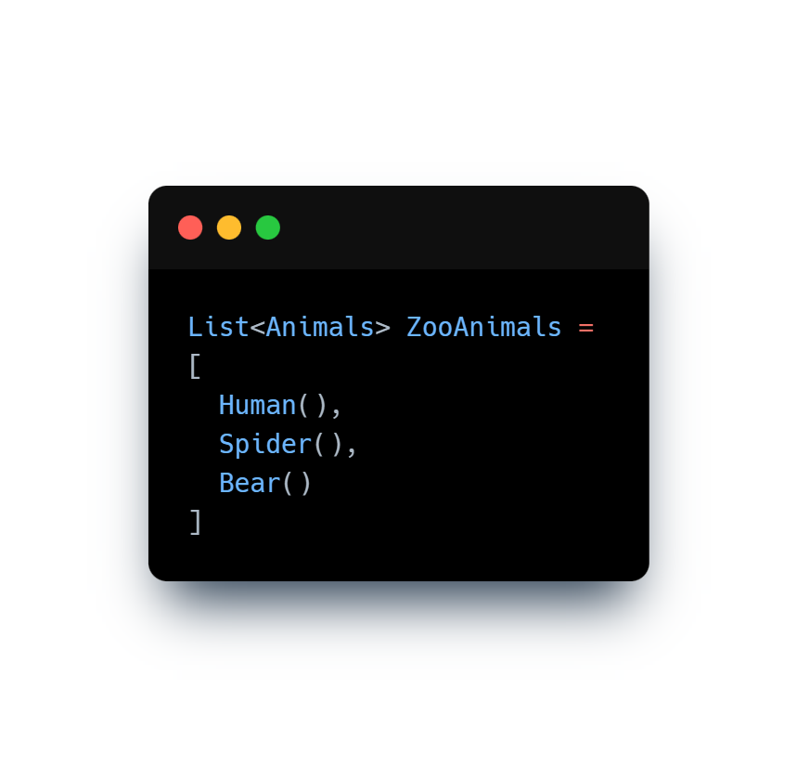
Casting
As we know, the child classes will inherit the code from the base class. Moreover, the child classes are also the same type as the parent class. That is to say, a Human is an Animal, a Spider is an Animal, and a Bear is an Animal. Any classes that inherit from the Animal type is itself an Animal type. In in other words, Animal type can be a Human, a Spider, or a Bear. This ability for Animal to become these various types is called polymorphism.
As a consequence of this, when you have a chain of hierarchies, you will inevitably deal with type polymorphism. But what if you are have a Spider object and would like to go back to an Animal type? By casting, you can turn the Spider type into it’s Animal base class. Likewise, you can take this same object and cast it back to it’s Animal type. In this way, casting allows us to traverse through the inheritance hierarchy.
For instance, let’s use the Animal example from earlier. One way we can utilize type polymorphism is to create a list called ZooAnimals.
In this example, we have created a list that contains 3 different types of Animals. Notice how are list’s type is Animal, but the elements instantiate specific Animal types. Human, Spider, and Bear are allowed to be in this list because they are descendants of the Animal type

Slide 12
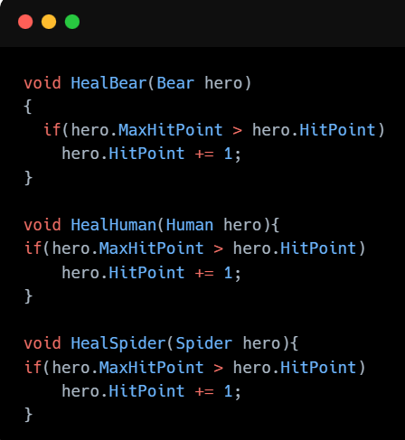
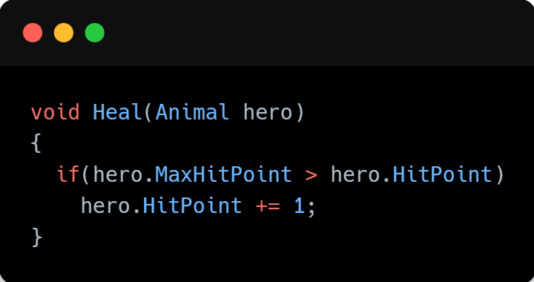
Casting (Another Example)
For instance, say that we are writing a game where we are using this Animal type which has a HitPoint field and a MaxHitPoint field both of integer type. We can implement a Heal function which restores life 1 life to our Animal
DRY (Don’t Repeat Yourself)

Slide 13
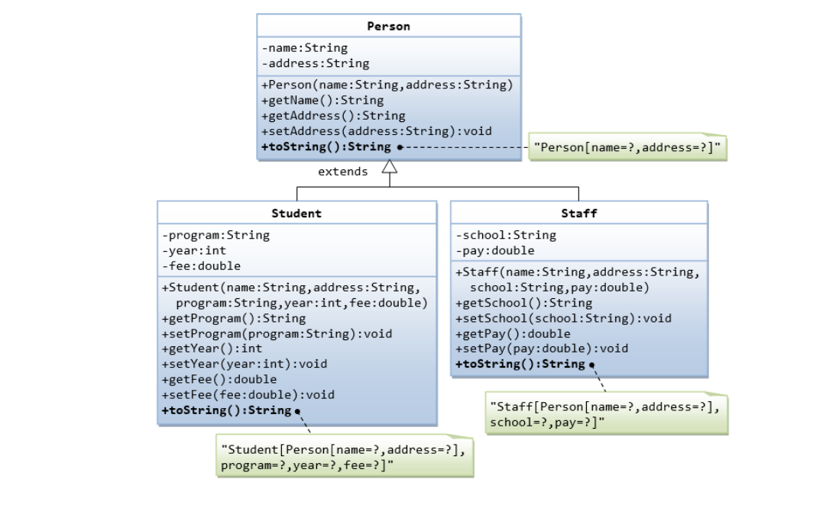
Let’s solve this

Slide 14
Abstraction

Slide 15
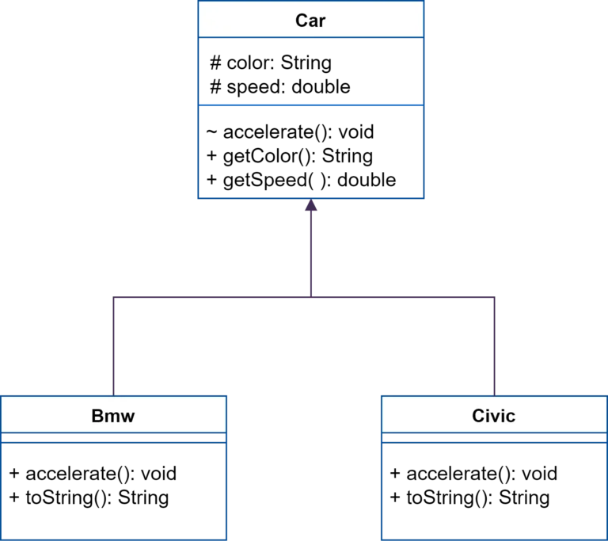
Abstraction
In this example car is an abstracted class that BMW and Civic inherit from it the accelerate function is an abstracted method, So it’s implementation will done in the BMW and Civic after the inheritance

Slide 16
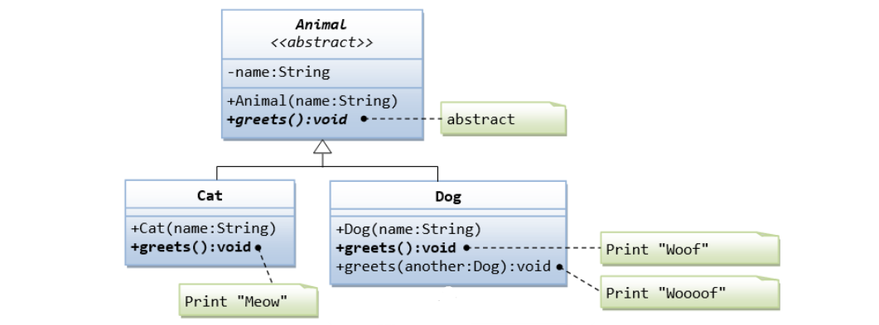
Let’s Solve

Slide 17

Break!!

Slide 18
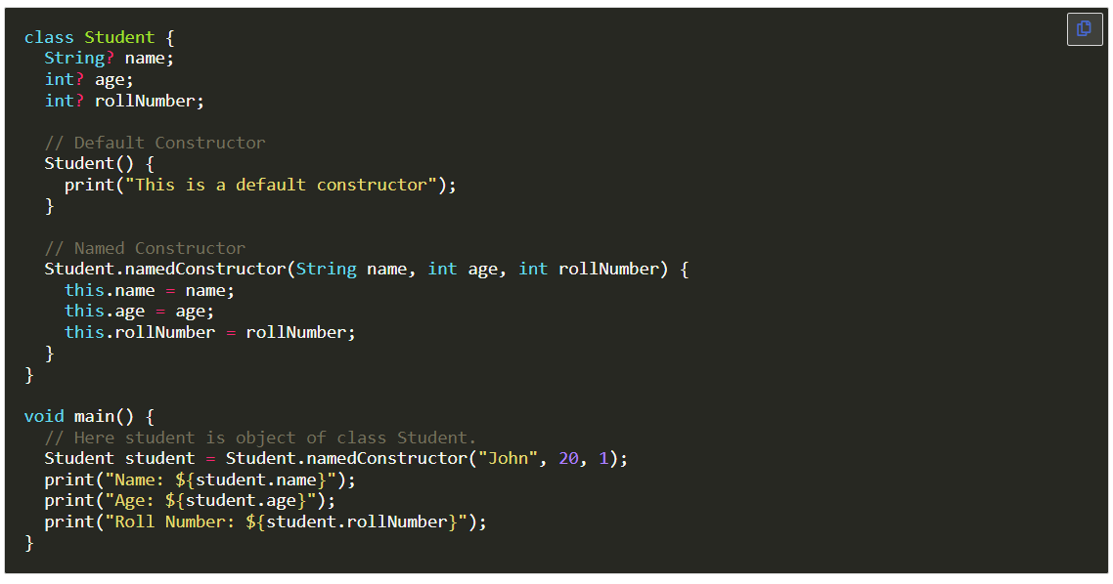
Named Constructor
In this example below, there is a class Student with three properties: name, age, and rollNumber. The class has two constructors. The first constructor is a default constructor. The second constructor is a named constructor. The named constructor is used to initialize the values of the three properties. We also have an object of the class Student called student.

Slide 19
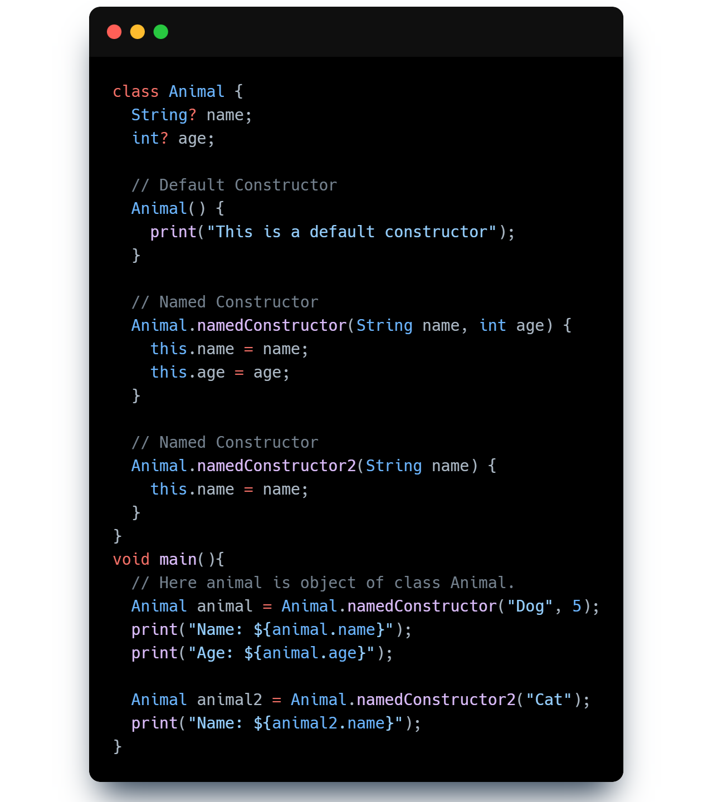
Named Constructor
In this example below, there is a class Animal with two properties name and age. The class has three constructors. The first constructor is a default constructor. The second and third constructors are named constructors. The second constructor is used to initialize the values of name and age, and the third constructor is used to initialize the value of name only. We also have an object of the class Animal called animal.

Slide 20

Flutter Introduction

Slide 21
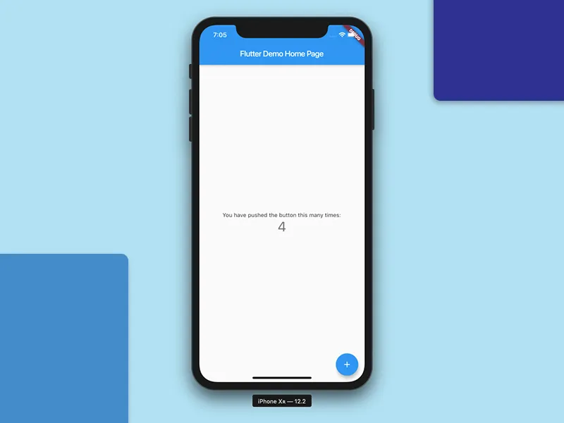
Understanding Counter App

Slide 22
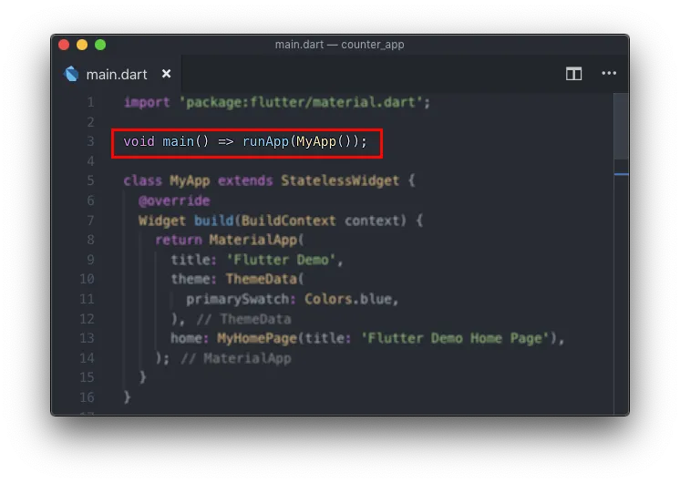
Main()

Slide 23
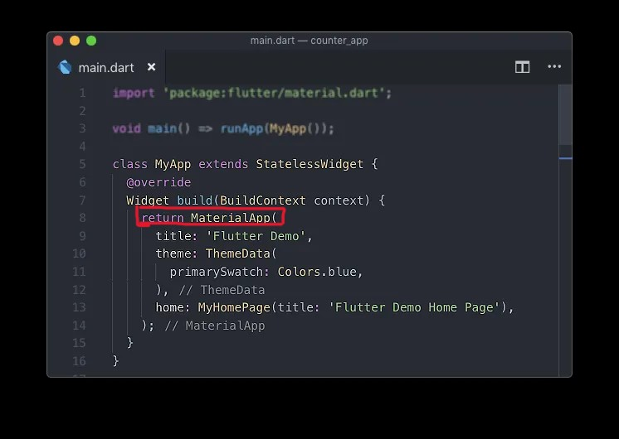
Material App

Slide 24
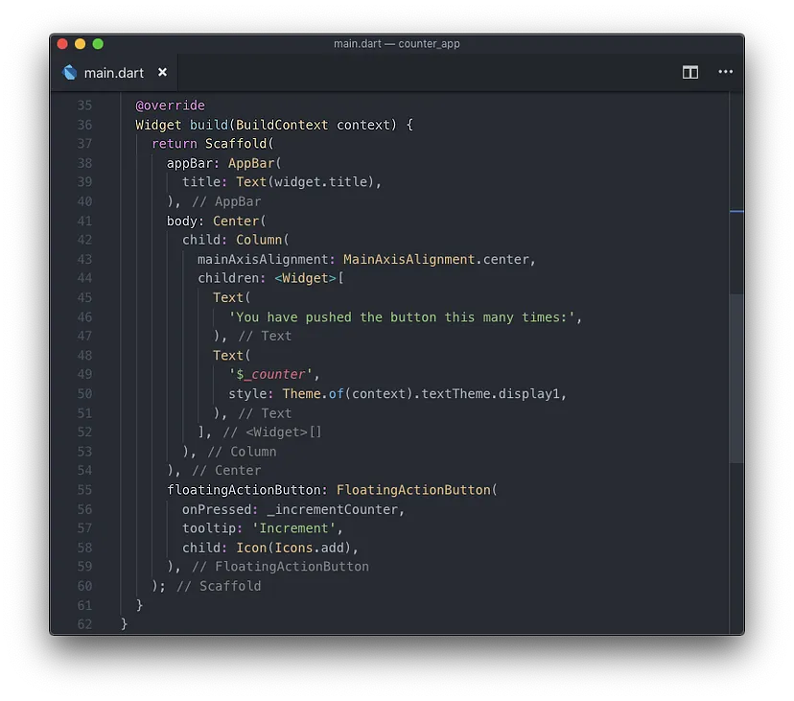
Scaffold

Slide 25
Difference between main() , materialApp(),Scaffold()
The main function by itself is the Dart entry point of an application. What makes the Flutter application take the scene is the runApp function called by passing a widget as a parameter, which will be the root widget of the application (the application itself).
MaterialApp is a widget that introduces a number of widgets (Navigator, Theme ) that are required to build a Material design app.
While Scaffold let you implement the material standard app widgets that most application has. Such as AppBar, BottomAppBar, FloatingActionButton, BottomSheet, Drawer, Snackbar.
The Scaffold is designed to be the single top-level container for a MaterialApp although it is not necessary to nest a Scaffold

Slide 26

Thank You!!

